Slide 1

NoSQL and MongoDB
Thusithanjana Thilakarathna

Slide 2

Learning Outcomes
Differentiate between relational databases and non relational databases.
Understand the usage of NoSQL
List different types of NoSQL databases
Understand the usage of MongoDB
Understand security aspects of MongoDB

Slide 3

Introduction to NoSQL
NoSQL databases are tailored for specific data models.
They have flexible schemas for modern applications.
Easy to develop, with great functionality and scalability.
NoSQL databases use different data models for data management.
Optimized for apps requiring large data volumes, low latency, and flexibility.
Achieved by relaxing some data consistency restrictions of other databases.
Notes:
Vertical scalability: This involves increasing the resources of a single server, such as adding more memory, CPUs, or storage, to handle more data and users. However, there is a limit to how much a single server can be scaled vertically, and it can become prohibitively expensive as the resources required to support large-scale data and user requirements grow.
Horizontal scalability: This involves distributing the workload across multiple servers, also known as sharding or partitioning. In this approach, the data is divided into smaller subsets, and each subset is stored on a separate server. This allows the database to handle a much larger volume of data and user requests by distributing the workload across multiple servers. However, horizontal scalability can be more complex to implement and manage than vertical scalability.

Slide 4
Relational Databases vs Non-Relational Databases
 | Relational Databases | Non-Relational Databases
Structure | Structured, with defined relationships between tables | Flexible, allowing for dynamic and changing data structures
Query Language | Uses SQL for querying data | Uses various querying languages, including JSON and BSON
Data Consistency | Enforces strict data consistency rules | Often prioritizes availability and partition tolerance over consistency
Popularity | Widely used and has a long history in the tech industry | Gained popularity with the rise of big data and modern web applications
Transactions and Operations | Well-suited for complex transactions and operations | Often faster and more scalable than relational databases
Purpose | Best suited for structured data and complex queries | Best suited for unstructured data and high scalability
Scalability | Vertical scaling is more common, but limited | Horizontal scaling is more common, and highly scalable
Examples | MySQL, Oracle, Microsoft SQL Server | MongoDB, Cassandra, Couchbase
Data Volume | Good for small to medium data volumes | Good for large data volumes
Cost | Relatively expensive | Relatively cheap
Use Cases | Financial institutions, transactional systems, inventory management | Big data, IoT, content management, cloud computing

Slide 5
Example
In a relational database, a book record is often dissembled (or “normalized”) and stored in separate tables, and relationships are defined by primary and foreign key constraints. In this example, the Books table has columns for ISBN, Book Title, and Edition Number, the Authors table has columns for AuthorID and Author Name,
and finally, the Author-ISBN table has columns for AuthorID and ISBN. The relational model is designed to enable the database to enforce referential integrity between tables in the database, normalized to reduce the redundancy, and generally optimized for storage.
In a NoSQL database, a book record is usually stored as a JSON document. For each book, the item, ISBN, Book Title, Edition Number, Author Name, and AuthorID are stored as attributes in a single document. In this model, data is optimized for intuitive development and horizontal scalability.

Slide 6
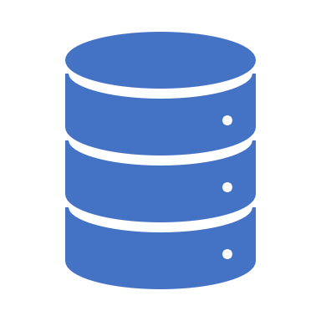
Why should you use a NoSQL database?
NoSQL databases are a great fit for many modern applications such as mobile, web, and gaming that require flexible, scalable, high-performance, and highly functional databases to provide great user experiences.
Flexibility: NoSQL databases generally provide flexible schemas that enable faster and more iterative development. The flexible data model makes NoSQL databases ideal for semi-structured and unstructured data.
Scalability: NoSQL databases are generally designed to scale out by using distributed clusters of hardware instead of scaling up by adding expensive and robust servers. Some cloud providers handle these operations behind-the-scenes as a fully managed service.
High-performance: NoSQL database are optimized for specific data models and access patterns that enable higher performance than trying to accomplish similar functionality with relational databases.
Highly functional: NoSQL databases provide highly functional APIs and data types that are purpose built for each of their respective data models.

Slide 7

Types of NoSQL Databases
Key-value
Document
Graph
In-memory
Wide-column stores
Object-Oriented

Slide 8
Key-value Databases
Key-value databases are designed for horizontal scaling and high partitioning capabilities.
Key-value databases excel in use cases such as gaming, ad tech, and IoT, where quick data access and update is important.
Use Cases
Gaming: where quick and efficient data access and updates are critical. Examples include leaderboards, in-game purchases, and user profiles.
Ad tech: to store and retrieve user data in real-time. This allows for targeted advertising and personalized user experiences.
IoT: which generate large volumes of data that need to be processed quickly.
Distributed caching: distributed caching systems to improve application performance and reduce database load.
E-commerce: to store and retrieve product information, user preferences, and shopping cart data in real-time.
Social networks: to store user profiles, friend lists, and activity feeds.

Slide 9
Document Databases
In applications, data is often represented as objects or JSON-like documents.
Document databases use the same document model as application code.
The flexible and semi structured nature of documents allows for easy evolution.
Document model works well with catalogs, user profiles, and CMS.
Amazon DynamoDB and MongoDB are popular document databases.
Document databases offer powerful and intuitive APIs for flexible development.

Slide 10
Document Database Use Cases
Content management systems: Document databases are commonly used in content management systems to store and manage content, such as articles, blog posts, and multimedia files.
Product catalogs: It can be used to store product information, including product names, descriptions, images, and pricing information. This information can be easily accessed and updated as needed.
User profiles: It can be used to store and manage user profiles, including personal information, preferences, and activity history. This information can be easily updated and queried to provide a personalized user experience.
E-commerce: It can be used to store and manage product inventory, customer orders, and transaction history. This information can be easily queried and updated to provide a seamless e-commerce experience.
IoT: It can be used to store and manage sensor data from Internet of Things (IoT) devices. This information can be easily analyzed and visualized to monitor device performance and detect anomalies.

Slide 11
Graph Databases
Graph databases use a graph data model to represent and store data.
This data model consists of nodes (entities) and edges (relationships).
Graph databases are optimized for working with complex, interconnected data.
They are particularly useful for applications that involve analyzing relationships between data points.
Graph databases can scale horizontally to handle massive datasets.
They are commonly used in fields such as social media, e-commerce, and recommendation systems.

Slide 12
In-memory Databases
In-memory databases are optimized for handling large amounts of data in RAM, which allows for faster data processing and querying.
They are often used for real-time applications that require very low latency and high throughput, such as financial trading platforms or online gaming.
In-memory databases can also be used in conjunction with disk-based databases as a caching layer to improve performance for frequently accessed data.
Some in-memory databases, such as Redis, have built-in support for advanced data structures like lists, sets, and maps, making them well-suited for complex data processing tasks.
In-memory databases typically require more memory and may be more expensive than disk-based databases due to the cost of RAM. However, their fast performance and ability to handle high volumes of data can make them a cost-effective solution for certain use cases.
In-memory databases are used for modern, microservices applications
Tinder relies on in-memory data stores for real-time response
Notes:
Redis: Redis (Remote Dictionary Server) is an open-source, in-memory data structure store that can be used as a database, cache, and message broker. It supports data structures such as strings, hashes, lists, sets, and sorted sets. Redis is widely used for real-time applications, messaging systems, and caching.
SAP HANA: SAP HANA is an in-memory database platform that is used for real-time analytics and applications. It supports both transactional and analytical processing, and it can process large amounts of data in real-time.
Apache Ignite: Apache Ignite is an open-source, in-memory computing platform that can be used as a distributed database, caching system, and processing framework. It supports SQL, key-value, and compute APIs, and it can be used for real-time applications, stream processing, and machine learning.
MemSQL: MemSQL is an in-memory, distributed SQL database that supports both transactional and analytical workloads. It can be used for real-time analytics, operational analytics, and transactional applications.
VoltDB: VoltDB is an in-memory, distributed SQL database that is designed for high-speed transactions and real-time analytics. It supports SQL, Java, and C++ APIs, and it can be used for applications such as financial trading, gaming, and ad tech.
Oracle TimesTen: Oracle TimesTen is an in-memory, relational database that is designed for high-speed transaction processing and real-time analytics. It can be used as a standalone database or as an in-memory cache for Oracle Database.

Slide 13
Wide Column Stores
Wide-column stores, also known as column-family stores, are designed to store and manage large amounts of structured data.
The data is organized into columns, which can be grouped together into column families.
Column families can have different schema and access patterns, providing flexibility for different use cases.
Wide-column stores are often used for time-series data, as well as for storing and analyzing large datasets in real-time.
Popular wide-column stores include Apache Cassandra, Apache HBase, and Google Bigtable.
These databases are optimized for read and write performance, as well as for high availability and fault tolerance.
They are also designed to scale horizontally, meaning that they can handle large volumes of data across multiple nodes.
Wide-column stores are used in a variety of industries, including finance, e-commerce, and social media.
Some common use cases include ad targeting, fraud detection, and content management systems.
The data stored in wide-column stores is often accessed using SQL-like languages or APIs.

Slide 14
Difference Between Wide-column Stores and Relational Databases
Data model: Wide-column stores use a column-family data model while relational databases use a table-based data model.
Schema flexibility: Wide-column stores have flexible schema, meaning that each row in a table can have a different set of columns, whereas relational databases have a fixed schema.
Scalability: Wide-column stores are designed to scale horizontally by adding more nodes to a cluster, while relational databases are typically scaled vertically by adding more powerful hardware.
Performance: Wide-column stores are optimized for read-heavy workloads and can perform very well on large-scale data sets, whereas relational databases are better suited for transactions and consistency.
Query language: Wide-column stores usually use a proprietary query language specific to the database, while relational databases use SQL.
Use cases: Wide-column stores are well-suited for applications with large-scale data and complex queries, such as big data analytics and real-time data processing, while relational databases are typically used for transactional applications such as e-commerce, financial systems, and human resources management.

Slide 15

Object-Oriented Databases
Object-Oriented Databases (OODBMS) store objects directly, rather than in tables.
They allow for complex data structures and support inheritance and polymorphism.
OODBMS provide efficient and flexible access to complex data, ideal for applications with complex data needs.
They support complex querying and allow for fine-grained access control.
OODBMS are popular in industries like finance, telecommunications, and aerospace.
Examples: db4o, Versant, Objectivity/DB, Apache Cassandra

Slide 16
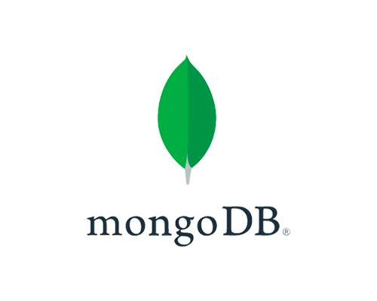

Slide 17

Introduction to MongoDB
MongoDB is a document-oriented NoSQL database system that stores data in a flexible, JSON-like format called BSON.
This allows for dynamic schema design and easy integration with object-oriented programming languages.
Unlike traditional relational databases, MongoDB uses a distributed architecture that enables it to scale horizontally across multiple servers or clusters.

Slide 18
Key Features of MongoDB
Dynamic schema: MongoDB has a flexible schema, which allows you to store data of different types and structures in the same collection. This makes it easier to work with data that doesn't fit neatly into a fixed schema.
High scalability: MongoDB is designed to be highly scalable, both vertically and horizontally. You can easily scale up or down by adding or removing nodes to your cluster, depending on your needs.
High availability: MongoDB provides high availability through replication and automatic failover. You can configure your cluster to automatically promote a secondary node to become the primary node in the event of a failure.
Rich query language: MongoDB supports a rich query language that allows you to perform complex queries on your data. You can use aggregation, indexing, and full-text search to analyze and retrieve data.
Flexible data model: MongoDB allows you to store data of different types and structures in the same collection. This makes it easy to work with data that doesn't fit neatly into a fixed schema.
MapReduce: MongoDB provides built-in support for MapReduce, which is a programming model for processing large data sets. This allows you to perform complex data transformations on large volumes of data.

Slide 19
Scalability
Sharding
MongoDB provides a built-in sharding feature.
Sharding involves partitioning data across multiple servers, called shards.
Sharding divides data into smaller chunks and distributes them across servers.
Each server in the cluster stores a subset of the data.
The shards are distributed based on a predefined shard key.
This allows MongoDB to scale horizontally by adding more servers to the cluster as needed.
Replica Sets
MongoDB replica sets allow you to create a group of servers.
Each server in the replica set stores a copy of the data.
The replica set can elect a primary server, which serves all write requests.
The other servers in the replica set serve as secondary servers, which replicate the data from the primary server.
This allows MongoDB to scale horizontally by adding more secondary servers to the replica set as needed.
Distributed Queries
MongoDB supports distributed queries.
Distributed queries allow you to run a single query across multiple servers in a sharded cluster.
This is useful when you need to aggregate data from multiple shards.
Distributed queries allow MongoDB to scale horizontally by distributing the query workload across multiple servers.

Slide 20
Availability
Replica Sets: Group of servers where each stores a copy of the data, allows automatic election of new primary server if one fails.
Read Preference Modes: Configures read operations to distribute workload across multiple servers and continue even if primary server fails.
Automatic Failover: Elected new primary server automatically if the current one fails, ensuring write operations can continue.
Cluster Manager: Monitors health of MongoDB cluster and performs recovery actions, such as removing failed servers and replacing them with new ones.
Notes:
Replica Sets: As mentioned earlier, MongoDB replica sets allow you to create a group of servers, where each server stores a copy of the data. If the primary server in the replica set fails, another server in the set can be automatically elected as the new primary server, ensuring that write operations can continue.
Read Preference Modes: MongoDB provides read preference modes that allow you to configure how read operations are distributed across a replica set. By default, read operations are directed to the primary server, but you can configure MongoDB to direct read operations to secondary servers as well. This allows you to distribute the read workload across multiple servers and ensure that read operations can continue even if the primary server fails.
Automatic Failover: In addition to replica sets, MongoDB also provides automatic failover functionality that allows a new primary server to be elected automatically if the current primary server becomes unavailable. This ensures that write operations can continue even if the primary server fails.
Cluster Manager: MongoDB Enterprise provides a cluster manager that monitors the health of the MongoDB cluster and automatically performs recovery actions if necessary. For example, if a server fails, the cluster manager can automatically remove the failed server from the cluster and replace it with a new server.

Slide 21

CAP theorem
Consistency
Consistency means that all clients see the same data at the same time, no matter which node they connect to. For this to happen, whenever data is written to one node, it must be instantly forwarded or replicated to all the other nodes in the system before the write is deemed ‘successful.’
Availability
Availability means that any client making a request for data gets a response, even if one or more nodes are down. Another way to state this—all working nodes in the distributed system return a valid response for any request, without exception.
Partition tolerance
A partition is a communications break within a distributed system—a lost or temporarily delayed connection between two nodes. Partition tolerance means that the cluster must continue to work despite any number of communication breakdowns between nodes in the system.

Slide 22
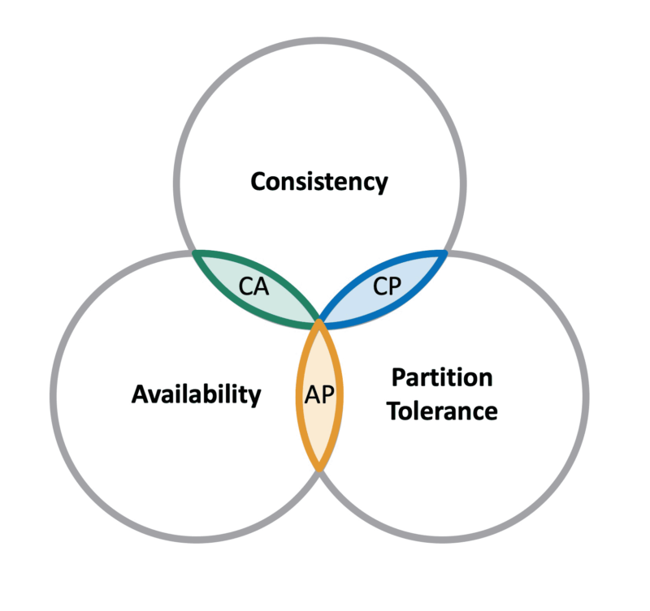
CAP theorem NoSQL database types
CP database: A CP database delivers consistency and partition tolerance at the expense of availability. When a partition occurs between any two nodes, the system has to shut down the non-consistent node (i.e., make it unavailable) until the partition is resolved.
AP database: An AP database delivers availability and partition tolerance at the expense of consistency. When a partition occurs, all nodes remain available but those at the wrong end of a partition might return an older version of data than others. (When the partition is resolved, the AP databases typically resync the nodes to repair all inconsistencies in the system.)
CA database: A CA database delivers consistency and availability across all nodes. It can’t do this if there is a partition between any two nodes in the system, however, and therefore can’t deliver fault tolerance.

Slide 23
MongoDB and the CAP theorem
MongoDB is a CP data store, prioritizing consistency over availability when resolving network partitions.
Each replica set has one primary node for write operations and secondary nodes that replicate the primary node's operation log.
By default, clients read from the primary node, but can specify a read preference to read from secondary nodes.
If the primary node fails, the secondary node with the latest operation log becomes the new primary node.
Clients can't make write requests during this interval, ensuring data consistency across the network.

Slide 24
Real life examples for MongoDB Applications
E-commerce and retail
Social networking and online communities
Gaming and entertainment
Healthcare and scientific research
Financial services
Internet of Things (IoT)
Advertising and Marketing
Content Management

Slide 25
Security
Authentication: MongoDB supports several methods of authentication, including username/password, X.509 certificates, and LDAP. By default, authentication is disabled, but it is recommended to enable it in production environments.
Authorization: MongoDB supports role-based access control (RBAC), which allows administrators to define roles and privileges for users and applications. RBAC can be used to restrict access to specific databases or collections, as well as to specific CRUD (create, read, update, delete) operations.
Encryption: MongoDB supports encryption at rest and in transit. At rest, data can be encrypted using the WiredTiger encryption engine, which encrypts data on disk using AES-256 encryption. In transit, data can be encrypted using SSL/TLS, which provides secure communication between clients and servers.
Auditing: MongoDB provides auditing capabilities that allow administrators to track user and application activity, including authentication and authorization events, database and collection access, and CRUD operations. Audit logs can be stored in a separate MongoDB database or exported to a syslog server.
Network security: MongoDB supports several network security features, such as IP whitelisting, SSL/TLS encryption, and LDAP/SASL authentication. Administrators can configure network security settings to control access to MongoDB servers and to ensure secure communication between clients and servers.
Application security: MongoDB provides several features that help developers write secure applications, such as parameterized queries, input validation, and SSL/TLS encryption. Developers should follow best practices for secure coding and use MongoDB drivers that support secure communication protocols.
Notes:
LDAP stands for Lightweight Directory Access Protocol.
It is used to access and manage directory information services (DIT) over a network.
LDAP is often used for authentication and authorization purposes, as well as storing information about users, groups, and network resources in a centralized directory.
LDAP is designed to be lightweight and uses a client-server model.
LDAP directory services are hierarchical and organized into a tree-like structure, with each entry uniquely identified by a distinguished name (DN).
LDAP entries can contain various attributes, such as name, address, phone number, and email address, which can be used for authentication and authorization purposes.
LDAP is widely used in enterprise networks and various Internet protocols, such as email, instant messaging, and web browsing.
SSL stands for Secure Sockets Layer, and it is a protocol used to provide secure communication over the internet. SSL was later replaced by TLS (Transport Layer Security) protocol, but the term SSL is still commonly used to refer to both protocols.
SSL stands for Secure Sockets Layer, and it is a protocol used to provide secure communication over the internet.
SSL/TLS provides encryption and authentication mechanisms that allow sensitive information to be transmitted securely over the internet.
SSL/TLS works by establishing a secure connection between a client and a server, using a combination of public and private keys.
SSL/TLS also provides authentication mechanisms to ensure that the client is communicating with the intended server.
SSL/TLS is widely used on the internet to secure web browsing, email, instant messaging, and other internet protocols.
The term SSL is commonly used to refer to both SSL and TLS protocols.
When you see "https" in the URL of a website, it means that SSL/TLS is being used to secure the connection between your browser and the website's server.
SSL/TLS is a critical component of secure internet communication and helps to protect sensitive information from interception and unauthorized access.

Slide 26
Getting Started with MongoDB
Will continue in the Tutorial

Slide 27

Thank you!
https://www.mongodb.com/what-is-mongodb/features
https://www.mongodb.com/docs/v5.0/security/
https://www.npmjs.com/package/mongodb
https://medium.com/system-design-concepts/dating-application-system-design-aae411412267
https://redis.io/
https://www.mongodb.com/developer/products/mongodb/storing-large-objects-and-files/
https://www.ibm.com/cloud/blog/sql-vs-nosql

